Slide 1


analytics challenge Partner:
BY
Team Radiants

Slide 2
Problem statement 2
The measurement of business vs. leisure travel has always been difficult. The rise of “bleisure” further complicates the matter. What signals in the data provided can help distinguish whether a trip represents business, leisure, or “bleisure” travel? For those purely leisure guests, what information would you use to make recommendations on specific leisure destinations they should considered? Where on the digital properties would you make these recommendations and why?

Slide 3
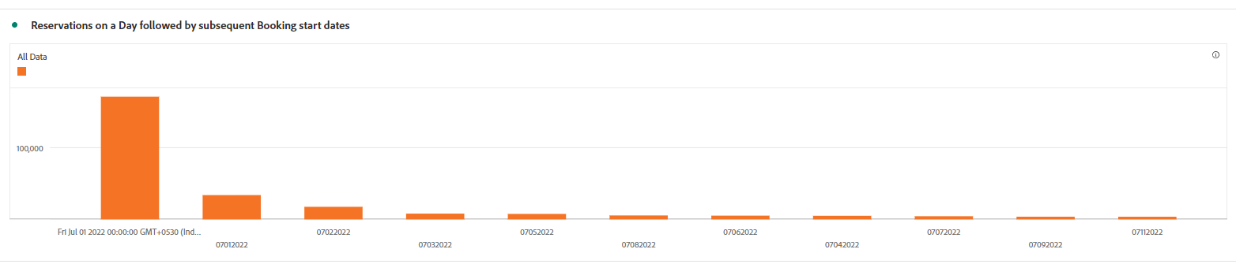
Indicating Parameters
1) Advanced Booking
Leisure Travelers spend their own money, hence being extremely mindful of cost effectiveness, they tend to reserve their Airlines as well as Hotel more than a Month or sometimes even three Months In advanced. On the contrast, business travelers, tend to reserve on the day of arrival or couple of days before.
On Analyzing, it was observed that most reservations start dates were within a short span of days, majority of which starting just the day after the booking date, this indicates:
Urgency or Impulsiveness, of the bookings, indicates the probability of business travel, however, to support this, we will explore this parameter combined with the other parameter, that is, the Booking Stay length.

Slide 4
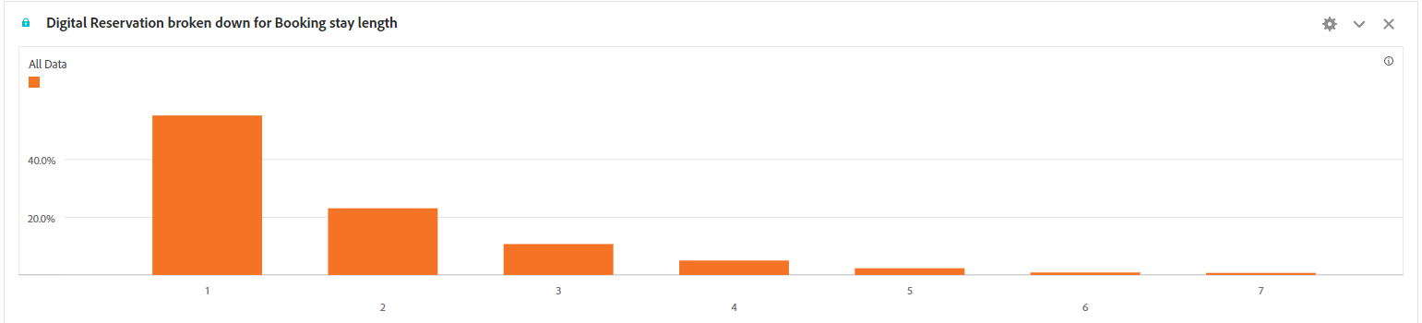
Indicating Parameters
2)Booking Length
This is where the difference between Leisure and Business travel starts to diminish, though we may still be able to use other indicators like, is the booking weekdays, or is it holiday season, or maybe the mix of weekdays and weekends. An average employee stays and deals with official business for three to four days.
Maximum number of reservations are 1 days, and the graph flattens for following days, indicating Business travel upto three to four days. After which bookings for the leisure gets more probabilistic, again as mentioned above, these parameters alone are not sufficient for any conclusions or potential solutions, hence we need more parameters.

Slide 5
Indicating Parameters
3)Destination Type
Speaking from human Institution, reservations at property types of Resorts, Leisure Properties, are of leisure travel. However, the main takeaways are prediction of destination type based on Property type as there are no direct
Maximum number of reservations are 1 days, and the graph flattens for following days, indicating Business travel upto three to four days. After which bookings for the leisure gets more probabilistic, again as mentioned above, these parameters alone are not sufficient for any conclusions or potential solutions, hence we need more parameters.

Slide 6
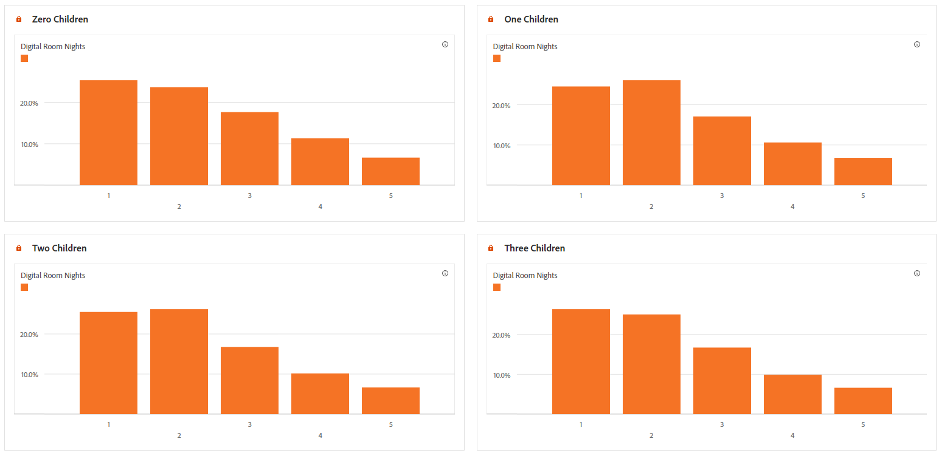
Indicating Parameters
4)Accompanying adults or children
Speaking from human Institution, reservations at property types of Resorts, Leisure Properties, are of leisure travel. However, the main takeaways are prediction of destination type based on Property type as there are no direct
The data shows slight correlation of Booking Stay length and Number of Children, the booking stay length being increased for increase in number or for even single child at all.

Slide 7
Parameters to recommend leisure destinations
Families
Cost Effectiveness and Budget
Number of bookings
As observed, any company with the traveler increases the stay length, thus increasing the chances of the travel being leisure, the focus group for leisure travel should be on individual with long stays and with multiple room bookings, this magnifies In the case of the company being children.
As Leisure travelers are Paying with their own money, they are looking at different sites and mediums and comparing aggressively, thus the leisure destinations should match their budget.
We have already seen, one of the indicators are number of adults, when clubbed with booking length, it gives a fair picture weather it’s a family holiday or group trip.
Where and when to push for Recommendations
The main fallout points across all experiences are Launch or Home page, more people exit and enter from here, to captivate people's attention, the home page is the right spot to push recommendations based on their previous searches or reservations.

Slide 8

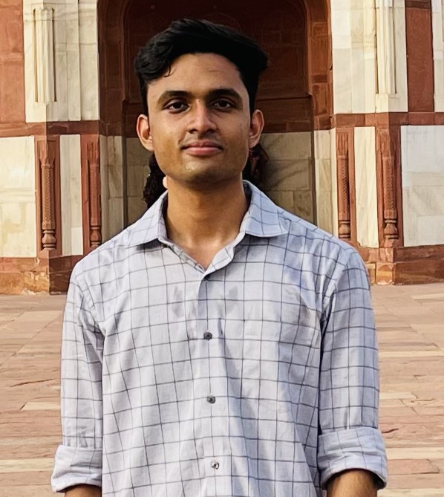

MEET THE TEAM
Mohammad Ausaf
Abhinav Singh
Mohammad Haris
Team Leader

Slide 9
THANK YOU

